Slide 1
Confidence Intervals and Hypothesis Testing
Part 1
BUAN/MECO 6312
Dr. Moran Blueshtein
University of Texas - Dallas

Slide 2
Confidence Intervals (CI)

Slide 3
The estimate b₂ is a point estimate of the unknown population parameter β₂ in the regression model.
However, the point estimate alone gives no sense of its reliability.
Is our point estimate close to the true parameter?

Slide 4
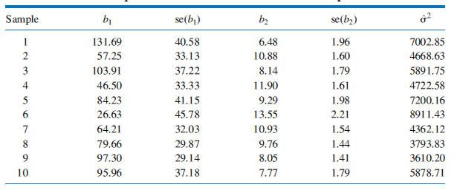
Estimates from 10 Random Samples
The Repeated Sampling Context

Slide 5
Confidence Intervals
The confidence interval proposes a range of values in which the true parameter is likely to fall.
The confidence interval incorporates both the point estimate (of the unknown population parameter β), and the estimate of the standard error of the estimator, which is a measure of the variability of the least squares estimator.

Slide 6
Review : the t -distribution
The least squares estimator of β₂, is
A standardized normal random variable is obtained from b₂ by subtracting its mean and dividing by its standard error:

Slide 7
Review : the t -distribution
Replacing σ² with creates a random variable t:
The ratio has a t-distribution with (N – 2) degrees of freedom, which we denote as:
Review : the t -distribution

Slide 8
Review:
The t-Distribution
What is the t-distribution?
The t-distribution is a bell shaped curve centered at zero
It looks like the standard normal distribution, except it is more spread out, with a larger variance and thicker tails
The shape of the t-distribution is controlled by a single parameter called the degrees of freedom, often abbreviated as df
As the number of degrees of freedom grows, the t-distribution approaches the normal distribution with mean 0 and variance 1

Slide 9
Review: The t-Distribution

Slide 10
Confidence Intervals and Hypothesis Testing
Part 2
BUAN/MECO 6312
Dr. Moran Blueshtein
University of Texas - Dallas

Slide 11
Hypothesis Tests

Slide 12
Hypothesis Tests
Hypothesis testing procedures compare a conjecture (a null hypothesis) that we have about a population to the information contained in a sample of data.

Slide 13
Hypothesis Tests
The Null Hypothesis
A null hypothesis is the belief we will maintain until we are convinced by the sample evidence that it is not true, in which case we reject the null hypothesis
The null hypothesis is stated as H₀ : β_{k} = c, where c is a constant, and is an important value in the context of a specific regression model

Slide 14
Hypothesis Tests
The Alternative Hypothesis
Paired with every null hypothesis is a logical alternative hypothesis H₁ that we will accept if the null hypothesis is rejected.
Possible Alternative hypotheses are:
H₁ : β_{k} > c
H₁ : β_{k} < c
H₁ : β_{k} ≠ c

Slide 15
Hypothesis Tests
The Test Statistic
To decide whether to reject the null hypothesis or not to reject it, we perform a test:
The primary test statistic is:
If the null hypothesis H₀ : = c is true, then we can substitute c for and it follows that:
If the null hypothesis is not true, then the t-statistic does not have a t-distribution with N-2 degrees of freedom

Slide 16
Hypothesis Tests
The Rejection Region
We reject the null hypothesis if the test statistic falls in the “Rejection Region”
The “Rejection Region” consists of values that are unlikely and that have low probability of occurring when the null hypothesis is true
The chain of logic is:
‘‘If a value of the test statistic is obtained that falls in a region of low probability, then it is unlikely that the test statistic has the assumed distribution, and thus it is unlikely that the null hypothesis is true’’

Slide 17
Hypothesis Tests
The Rejection Region
The rejection region depends on the level of significance of the test α - is usually chosen to be 0.01, 0.05 or 0.10.

Slide 18
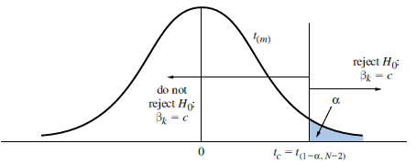
Rejection Regions for Specific Alternatives
Rejection region for a one-tail test of H₀:β_{k} = c against H₁:β_{k} > c
One-tail Test with Alternative “Greater Than”
When testing the null hypothesis H₀:β_{k} = c against the alternative hypothesis H₁:β_{k} > c, reject the null hypothesis and accept the alternative hypothesis if
t ≥ t_{(1-α;N-2)}

Slide 19
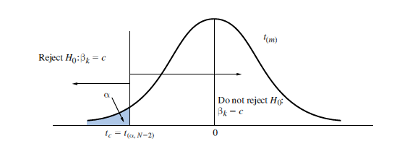
Rejection Regions for Specific Alternatives
Rejection region for a one-tail test of H₀:β_{k} = c against H₁:β_{k} < c
One-tail Test with Alternative “Less Than”
When testing the null hypothesis H₀:β_{k} = c against the alternative hypothesis H₁:β_{k} < c, reject the null hypothesis and accept the alternative hypothesis if
t ≤ t_{(α;N-2)}

Slide 20
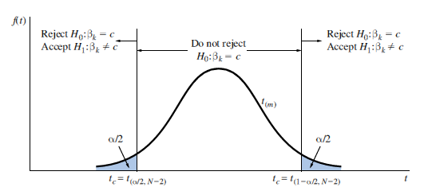
Rejection Regions for Specific Alternatives
Rejection region for a test of H₀:β_{k} = c against H₁:β_{k} ≠ c
Two-tail Test with Alternative “Not Equal To”
When testing the null hypothesis H₀:β_{k} = c against the alternative hypothesis H₁:β_{k} ≠ c, reject the null hypothesis and accept the alternative hypothesis if
t ≤ t_{(α/2;N-2)} or t ≥ t_{(1-α/2;N-2)}

Slide 21
Hypothesis Tests
The Rejection Region
We could commit two types of error
If we reject the null hypothesis when it is true, then we commit what is called a Type 1 error
The level of significance of a test is the probability of committing a Type I error
P(Type I error) = α
If we do not reject a null hypothesis that is false, then we have committed a Type II error
It is possible we don’t reject the null hypothesis although it is wrong!

Slide 22
Hypothesis Tests
Conclusion
Avoid saying that you ‘‘accept’’ the null hypothesis.
You either reject the null hypothesis, or do you not reject the null hypothesis

Slide 23
Examples of Hypothesis Tests

Slide 24
Examples of Hypothesis Tests
STEP-BY-STEP PROCEDURE FOR TESTING HYPOTHESES
Determine the null and alternative hypotheses. Specify the test statistic and its distribution if the null hypothesis is true. Select α and determine the rejection region. Calculate the sample value of the test statistic. State your conclusion.

Slide 25
Examples of Hypothesis Tests
One-tail Test of Significance
Is Food Expenditure increasing with income?
The null hypothesis is H₀:β₂ = 0
The alternative hypothesis is H₁:β₂ > 0
The test statistic: in this case c = 0, so t = b₂/se(b₂) ~ t_{(N – 2)} if the null hypothesis is true
Select α = 0.05
The critical value for the right-tail rejection region is the 95th percentile of the t-distribution with N – 2 = 38 degrees of freedom, t_{(0.95,38)} = 1.686.
Thus we will reject the null hypothesis if the calculated value of t ≥ 1.686. If t < 1.686, we will not reject the null hypothesis.

Slide 26
Examples of Hypothesis Tests
One-tail Test of Significance
Using the food expenditure data, we found that b₂ = 10.21 with standard error se(b₂) = 2.09
The value of the test statistic is:
Since t = 4.88 > 1.686, we reject the null hypothesis that β₂ = 0 and accept the alternative that β₂ > 0

Slide 27
Examples of Hypothesis Tests
One-tail Test of Significance
we reject the hypothesis that there is no relationship between income and food expenditure, and conclude that there is a statistically significant positive relationship between household income and food expenditure, at 5% significance level.

Slide 28
Examples of Hypothesis Tests
Left-tail Tests
Do households spend on food less than 15$ for every additional 100$ income?
The null hypothesis is H₀:β₂ ≥ 15
The alternative hypothesis is H₁:β₂ < 15
The test statistic is t = (b₂ - 15)/se(b₂) ~ t_{(N – 2)} if the null hypothesis is true
Select α = 0.05
The critical value for the left-tail rejection region is the 5th percentile of the t-distribution with N – 2 = 38 degrees of freedom, t_{(0.05,38)} = -1.686.
Thus we will reject the null hypothesis if the calculated value of t ≤ -1.686. If t > -1.686, we will not reject the null hypothesis

Slide 29
Examples of Hypothesis Tests
Left-tail Tests
Using the food expenditure data, we found that b₂ = 10.21 with standard error se(b₂) = 2.09
The value of the test statistic is:
Since t = -2.29 < -1.686 we reject the null hypothesis that β₂ ≥ 15 and accept the alternative that β₂ < 15 at α = 0.05

Slide 30
Examples of Hypothesis Tests
Left-tail Tests
We conclude that households spending on food is less than $15 for each additional $100 income at 5% significance level.
Will you reject the null hypothesis for significance level of 1%?

Slide 31
Examples of Hypothesis Tests
Two-tail Test of Significance
Is there is a relationship between income and food expenditure?
The null hypothesis is H₀:β₂ = 0
The alternative hypothesis is H₁:β₂ ≠ 0
The test statistic is t = (b₂)/se(b₂) ~ t_{(N – 2)} if the null hypothesis is true
Select α = 0.05
The critical value for the two-tail rejection region is the 2.5th percentile of the t-distribution with N – 2 = 38 degrees of freedom, t_{(0.025,38)} = -2.024 and the 97.5th percentile t_{(0.975,38)} = 2.024
Thus we will reject the null hypothesis if the calculated value of t ≥ 2.024 or if t ≤ -2.024

Slide 32
Examples of Hypothesis Tests
Two-tail Test of Significance
Using the food expenditure data, we found that b₂ = 10.21 with standard error se(b₂) = 2.09
The value of the test statistic is
Since 4.88 > 2.024 we reject the null hypothesis that β₂ = 0
We conclude that there is a statistically significant relationship between income and food expenditure (at 5% significance level).

Slide 33
Examples of Hypothesis Tests
Two-tail Test of Significance
Two-tail Test of Significance
Every regression output provides the calculated t value for the two tail test H₀:β₂ = 0

Slide 34
Linear Combinations of Parameters
Testing a Linear Combination of Parameters
A general linear hypothesis involves both parameters, β₁ and β₂ and may be stated as:
The alternative hypothesis might be any one of the following:

Slide 35
Linear Combinations of Parameters
Testing a Linear Combination of Parameters
The t-statistic is:
if the null hypothesis is true
The rejection regions for the one- and two-tail alternatives are the same as those described before, and conclusions are interpreted the same way as well

Slide 36
Linear Combinations of Parameters
Testing Expected Food Expenditure
Suppose we conjecture that:
This implies:
And the alternative hypothesis:

Slide 37
Linear Combinations of Parameters
Testing Expected Food Expenditure
The t-statistic is

Slide 38
Linear Combinations of Parameters
Testing Expected Food Expenditure
Since t =2.65 > t_{c} = 1.686, at significance level of 5%, we reject the null hypothesis that expected spending on food of households with weekly income of $2,000 is $250 per week or less and conclude that the expected spending is more than $250, at 5% significance level.
Will you reject the null hypothesis for significance level of 1%, 0.5%?

Slide 39
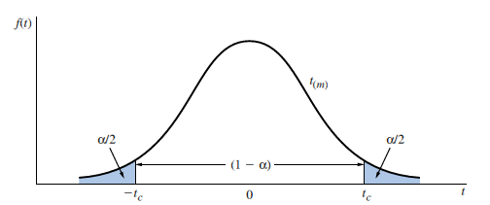
Review: The t-Distribution
Critical values from a t-distribution.
Each shaded ‘‘tail’’ area contains α/2 of the probability, so that 1-α of the probability is contained in the center portion

Slide 40
Review: The t-Distribution
We can find a “critical value” from a t-distribution such that
where α is a probability often taken to be α = 0.01 or α = 0.05.

Slide 41
Confidence Intervals
Obtaining Confidence Intervals
We can make the probability statement
Rearranging

Slide 42
Confidence Intervals
Obtaining Confidence Intervals
b_{k} ± t_{c}se(b_{k}) is called a 100(1-α)% confidence interval of β₂
Usually α = 0.01 or α = 0.05, so that we obtain a 99% confidence interval or a 95% confidence interval.

Slide 43
Confidence Intervals
An Illustration
For the food expenditure data
The critical value for α = .05 and 38 degrees of freedom is t_{c} = 2.024 (two tail test)
b₂ = 10.21 and its standard error:
A “95% confidence interval” for β₂

Slide 44
Confidence Interval
An Illustration
Every regression output provides the calculated 95% confidence interval

Slide 45
Confidence Intervals
An Illustration
Is β₂ actually inside the interval [5.97, 14.45]?
We do not know, and we will never know!
When the procedure we used is applied to many random samples of data from the same population, then 95% of all the confidence intervals constructed using this procedure will contain the true parameter
The interval estimation procedure ‘‘works’’ 95% of the time
What we can say that, given the reliability of the procedure, we would be ‘‘surprised’’ if β₂ is not in the interval [5.97, 14.45].

Slide 46
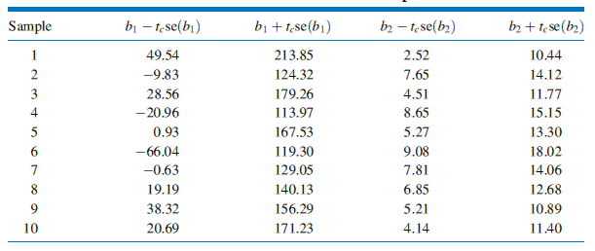
Confidence Intervals
Confidence Intervals from 10 Random Samples
The Repeated Sampling Context

Slide 47
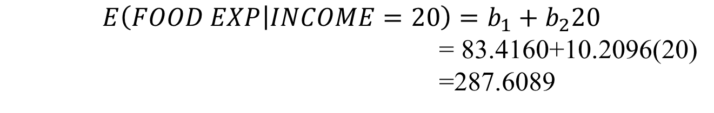
Confidence Interval for Linear Combinations of Parameters
An Illustration
Confidence Interval for a linear combination of parameters:
We estimate that the expected food expenditure by a household with $2,000 income is $287.61 per week
$$E\left(FOOD EXP | INCOME=20\right)=b_{1}+b_{2}20$$
= 83.4160+10.2096(20)
=287.6089

Slide 48
Confidence Interval for Linear Combinations of Parameters
An Illustration
The 95% interval is then:
or
We estimate with 95% confidence that the expected food expenditure of a household with $2,000 income is between $258.91 and $316.31

Slide 49
Linear Combinations of Parameters
If
Then, it is also true that linear combinations of normally distributed variables are normally distributed, so that
Where: λ = c₁β₁ + c₂β₂ ,

Slide 50
Linear Combinations of Parameters
How to calculate standard errors of linear combination of parameters?
 | C | Income
C | 1884.442 | -85.9032
Income | -85.9032 | 4.3818

Slide 51
Confidence Intervals and Hypothesis Testing
Part 2
BUAN/MECO 6312
Dr. Moran Blueshtein
University of Texas - Dallas

Slide 52
Hypothesis Tests

Slide 53
Hypothesis Tests
Hypothesis testing procedures compare a conjecture (a null hypothesis) that we have about a population to the information contained in a sample of data.

Slide 54
Hypothesis Tests
The Null Hypothesis
A null hypothesis is the belief we will maintain until we are convinced by the sample evidence that it is not true, in which case we reject the null hypothesis
The null hypothesis is stated as H₀ : β_{k} = c, where c is a constant, and is an important value in the context of a specific regression model

Slide 55
Hypothesis Tests
The Alternative Hypothesis
Paired with every null hypothesis is a logical alternative hypothesis H₁ that we will accept if the null hypothesis is rejected.
Possible Alternative hypotheses are:
H₁ : β_{k} > c
H₁ : β_{k} < c
H₁ : β_{k} ≠ c

Slide 56
Hypothesis Tests
The Test Statistic
To decide whether to reject the null hypothesis or not to reject it, we perform a test:
The primary test statistic is:
If the null hypothesis H₀ : = c is true, then we can substitute c for and it follows that:
If the null hypothesis is not true, then the t-statistic does not have a t-distribution with N-2 degrees of freedom

Slide 57
Hypothesis Tests
The Rejection Region
We reject the null hypothesis if the test statistic falls in the “Rejection Region”
The “Rejection Region” consists of values that are unlikely and that have low probability of occurring when the null hypothesis is true
The chain of logic is:
‘‘If a value of the test statistic is obtained that falls in a region of low probability, then it is unlikely that the test statistic has the assumed distribution, and thus it is unlikely that the null hypothesis is true’’

Slide 58
Hypothesis Tests
The Rejection Region
The rejection region depends on the level of significance of the test α - is usually chosen to be 0.01, 0.05 or 0.10.

Slide 59
Rejection Regions for Specific Alternatives
Rejection region for a one-tail test of H₀:β_{k} = c against H₁:β_{k} > c
One-tail Test with Alternative “Greater Than”
When testing the null hypothesis H₀:β_{k} = c against the alternative hypothesis H₁:β_{k} > c, reject the null hypothesis and accept the alternative hypothesis if
t ≥ t_{(1-α;N-2)}

Slide 60
Rejection Regions for Specific Alternatives
Rejection region for a one-tail test of H₀:β_{k} = c against H₁:β_{k} < c
One-tail Test with Alternative “Less Than”
When testing the null hypothesis H₀:β_{k} = c against the alternative hypothesis H₁:β_{k} < c, reject the null hypothesis and accept the alternative hypothesis if
t ≤ t_{(α;N-2)}

Slide 61
Rejection Regions for Specific Alternatives
Rejection region for a test of H₀:β_{k} = c against H₁:β_{k} ≠ c
Two-tail Test with Alternative “Not Equal To”
When testing the null hypothesis H₀:β_{k} = c against the alternative hypothesis H₁:β_{k} ≠ c, reject the null hypothesis and accept the alternative hypothesis if
t ≤ t_{(α/2;N-2)} or t ≥ t_{(1-α/2;N-2)}

Slide 62
Hypothesis Tests
The Rejection Region
We could commit two types of error
If we reject the null hypothesis when it is true, then we commit what is called a Type 1 error
The level of significance of a test is the probability of committing a Type I error
P(Type I error) = α
If we do not reject a null hypothesis that is false, then we have committed a Type II error
It is possible we don’t reject the null hypothesis although it is wrong!

Slide 63
Hypothesis Tests
Conclusion
Avoid saying that you ‘‘accept’’ the null hypothesis.
You either reject the null hypothesis, or do you not reject the null hypothesis

Slide 64
Examples of Hypothesis Tests

Slide 65
Examples of Hypothesis Tests
STEP-BY-STEP PROCEDURE FOR TESTING HYPOTHESES
Determine the null and alternative hypotheses. Specify the test statistic and its distribution if the null hypothesis is true. Select α and determine the rejection region. Calculate the sample value of the test statistic. State your conclusion.

Slide 66
Examples of Hypothesis Tests
One-tail Test of Significance
Is Food Expenditure increasing with income?
The null hypothesis is H₀:β₂ = 0
The alternative hypothesis is H₁:β₂ > 0
The test statistic: in this case c = 0, so t = b₂/se(b₂) ~ t_{(N – 2)} if the null hypothesis is true
Select α = 0.05
The critical value for the right-tail rejection region is the 95th percentile of the t-distribution with N – 2 = 38 degrees of freedom, t_{(0.95,38)} = 1.686.
Thus we will reject the null hypothesis if the calculated value of t ≥ 1.686. If t < 1.686, we will not reject the null hypothesis.

Slide 67
Examples of Hypothesis Tests
One-tail Test of Significance
Using the food expenditure data, we found that b₂ = 10.21 with standard error se(b₂) = 2.09
The value of the test statistic is:
Since t = 4.88 > 1.686, we reject the null hypothesis that β₂ = 0 and accept the alternative that β₂ > 0

Slide 68
Examples of Hypothesis Tests
One-tail Test of Significance
we reject the hypothesis that there is no relationship between income and food expenditure, and conclude that there is a statistically significant positive relationship between household income and food expenditure, at 5% significance level.

Slide 69
Examples of Hypothesis Tests
Left-tail Tests
Do households spend on food less than 15$ for every additional 100$ income?
The null hypothesis is H₀:β₂ ≥ 15
The alternative hypothesis is H₁:β₂ < 15
The test statistic is t = (b₂ - 15)/se(b₂) ~ t_{(N – 2)} if the null hypothesis is true
Select α = 0.05
The critical value for the left-tail rejection region is the 5th percentile of the t-distribution with N – 2 = 38 degrees of freedom, t_{(0.05,38)} = -1.686.
Thus we will reject the null hypothesis if the calculated value of t ≤ -1.686. If t > -1.686, we will not reject the null hypothesis

Slide 70
Examples of Hypothesis Tests
Left-tail Tests
Using the food expenditure data, we found that b₂ = 10.21 with standard error se(b₂) = 2.09
The value of the test statistic is:
Since t = -2.29 < -1.686 we reject the null hypothesis that β₂ ≥ 15 and accept the alternative that β₂ < 15 at α = 0.05

Slide 71
Examples of Hypothesis Tests
Left-tail Tests
We conclude that households spending on food is less than $15 for each additional $100 income at 5% significance level.
Will you reject the null hypothesis for significance level of 1%?

Slide 72
Examples of Hypothesis Tests
Two-tail Test of Significance
Is there is a relationship between income and food expenditure?
The null hypothesis is H₀:β₂ = 0
The alternative hypothesis is H₁:β₂ ≠ 0
The test statistic is t = (b₂)/se(b₂) ~ t_{(N – 2)} if the null hypothesis is true
Select α = 0.05
The critical value for the two-tail rejection region is the 2.5th percentile of the t-distribution with N – 2 = 38 degrees of freedom, t_{(0.025,38)} = -2.024 and the 97.5th percentile t_{(0.975,38)} = 2.024
Thus we will reject the null hypothesis if the calculated value of t ≥ 2.024 or if t ≤ -2.024

Slide 73
Examples of Hypothesis Tests
Two-tail Test of Significance
Using the food expenditure data, we found that b₂ = 10.21 with standard error se(b₂) = 2.09
The value of the test statistic is
Since 4.88 > 2.024 we reject the null hypothesis that β₂ = 0
We conclude that there is a statistically significant relationship between income and food expenditure (at 5% significance level).

Slide 74
Examples of Hypothesis Tests
Two-tail Test of Significance
Two-tail Test of Significance
Every regression output provides the calculated t value for the two tail test H₀:β₂ = 0

Slide 75
Linear Combinations of Parameters
Testing a Linear Combination of Parameters
A general linear hypothesis involves both parameters, β₁ and β₂ and may be stated as:
The alternative hypothesis might be any one of the following:

Slide 76
Linear Combinations of Parameters
Testing a Linear Combination of Parameters
The t-statistic is:
if the null hypothesis is true
The rejection regions for the one- and two-tail alternatives are the same as those described before, and conclusions are interpreted the same way as well

Slide 77
Linear Combinations of Parameters
Testing Expected Food Expenditure
Suppose we conjecture that:
This implies:
And the alternative hypothesis:

Slide 78
Linear Combinations of Parameters
Testing Expected Food Expenditure
The t-statistic is

Slide 79
Linear Combinations of Parameters
Testing Expected Food Expenditure
Since t =2.65 > t_{c} = 1.686, at significance level of 5%, we reject the null hypothesis that expected spending on food of households with weekly income of $2,000 is $250 per week or less and conclude that the expected spending is more than $250, at 5% significance level.
Will you reject the null hypothesis for significance level of 1%, 0.5%?

Slide 80
The p-Value

Slide 81
The p-Value
When reporting the outcome of statistical hypothesis tests, it has become standard practice to report the p-value (an abbreviation for probability value) of the test.
The p-value of the test tell us what is probability of committing a Type I error according to our t-statistic and the alternative hypothesis.

Slide 82
The p-Value
If t is the calculated value of the t-statistic, then:
if H₁: β_{K} > c
p = probability to the right of t
if H₁: β_{K} < c
p = probability to the left of t
if H₁: β_{K} ≠ c
p = sum of probabilities to the right of |t| and to the left of – |t|

Slide 83
The p-Value
p-VALUE RULE
Reject the null hypothesis when the p-value is less than, or equal to, the level of significance α:
If p ≤ α then reject H₀.
If p > α then do not reject H₀.

Slide 84
The p-Value
p-Value for a Left-tail Test
Example 1
The null hypothesis is H₀: β₂ ≥ 15
The alternative hypothesis is H₁: β₂ < 15
The p-value is (left tail test)
We reject the null hypothesis for α = 0.05 but not for α = 0.01.

Slide 85
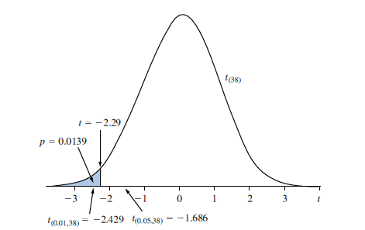
The p-Value
The p-value for a left-tail test.
p-Value for a Left-tail Test

Slide 86
The p– value
P- value for a Right tail Test
Example 2
The null hypothesis is H₀:β₂ = 0
The alternative hypothesis is H₁:β₂ > 0
The test statistic:
The p-value (right tail):
We reject the null hypothesis for both α = 0.05 and for α = 0.01.

Slide 87
The p-Value
p-Value for a Two-tail Test of Significance
Example 3
The null hypothesis is H₀: β₂ = 0
The alternative hypothesis is H₁: β₂ ≠ 0
The p-value is (a two tail test!)

Slide 88
The p-Value
p-Value for a Two-tail Test of Significance
Every regression output provides the calculated p-value for the two tail test of significance.

